Slide 1
Convolutional Neural Network

Slide 2
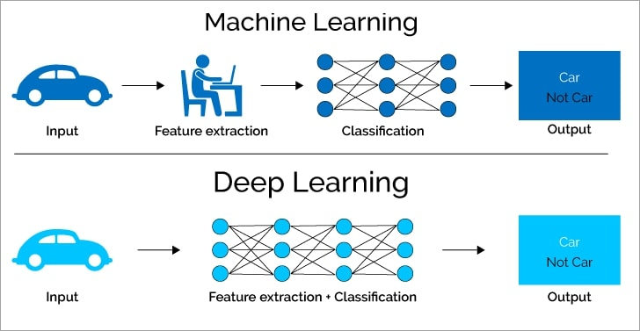
Machine Learning and Deep Learning

Slide 3
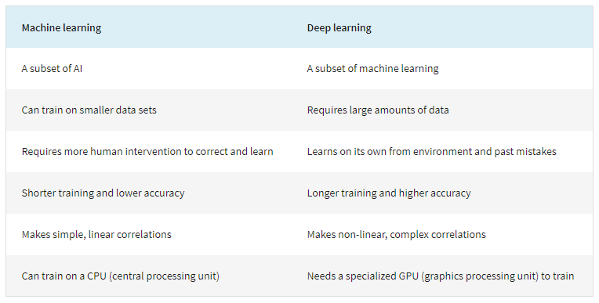
Machine Learning and Deep Learning

Slide 4
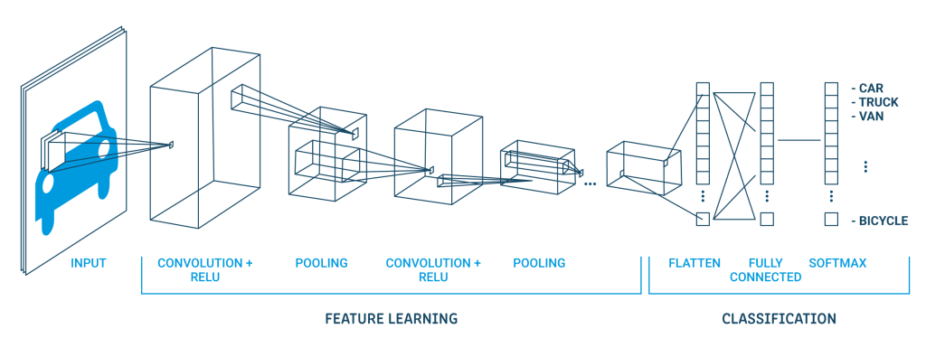
CNN

Slide 5

MNIST Dataset
MNIST Dataset:
  Grayscale images of handwritten digits (28*28 pixels).
  60.000 training images, 10.000 test images.
  Goal : to classify the images into their 10 categories(0 to 9).

Slide 6
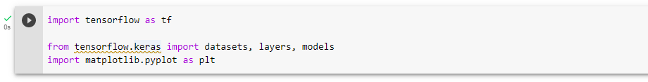
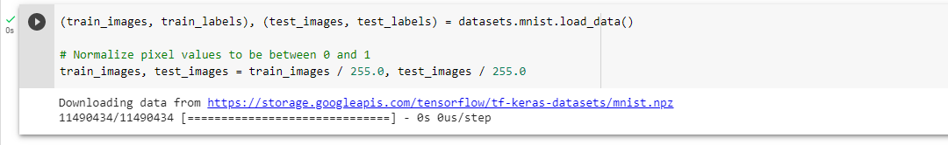
Loading the MNIST dataset

Slide 7
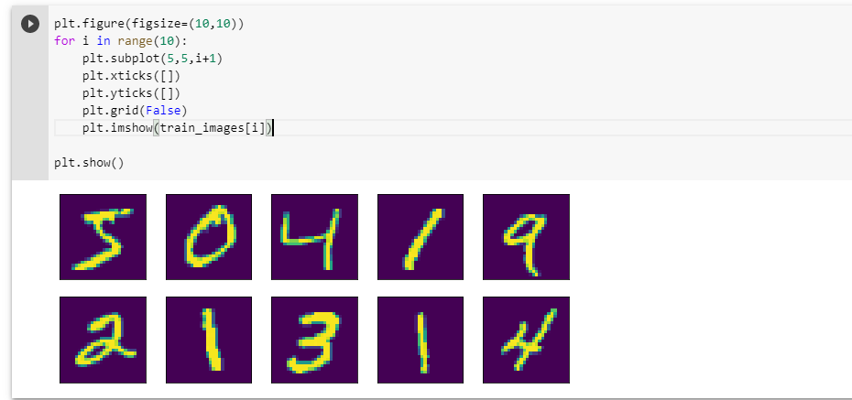
Show some samples of dataset

Slide 8
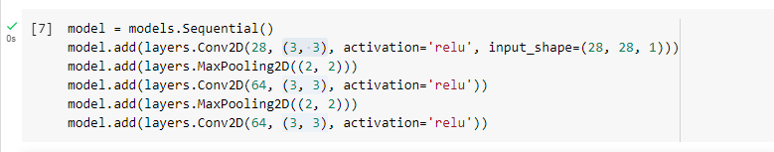
Create the convolutional base
As input, a CNN takes tensors of shape (image_height, image_width, color_channels).
In this example, you will configure your CNN to process inputs of shape (28, 28, 1), which is the format of MNIST images.

Slide 9
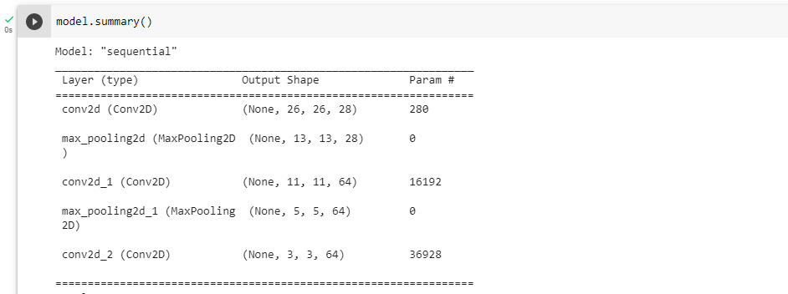
Create the convolutional base
Above, you can see that the output of every Conv2D and MaxPooling2D layer is a 3D tensor of shape (height, width, channels). The width and height dimensions tend to shrink as you go deeper in the network. The number of output channels for each Conv2D layer is controlled by the first argument (e.g., 32 or 64).

Slide 10

Add Dense layers on top
To complete the model, you will feed the last output tensor from the convolutional base (of shape (3, 3, 64)) into one or more Dense layers to perform classification.
Dense layers take vectors as input (which are 1D), while the current output is a 3D tensor.
First, you will flatten the 3D output to 1D, then add one or more Dense layers on top. MISNT has 10 output classes, so you use a final Dense layer with 10 outputs.

Slide 11
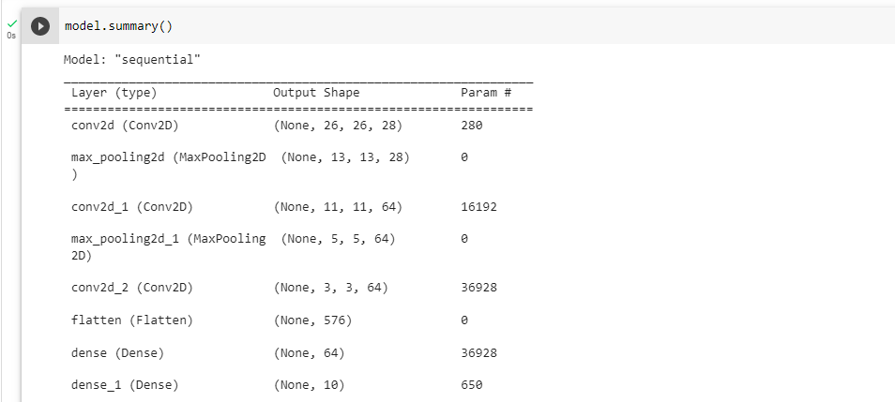
Add Dense layers on top
The network summary shows that (3, 3, 64) outputs were flattened into vectors of shape (576) before going through two Dense layers.

Slide 12
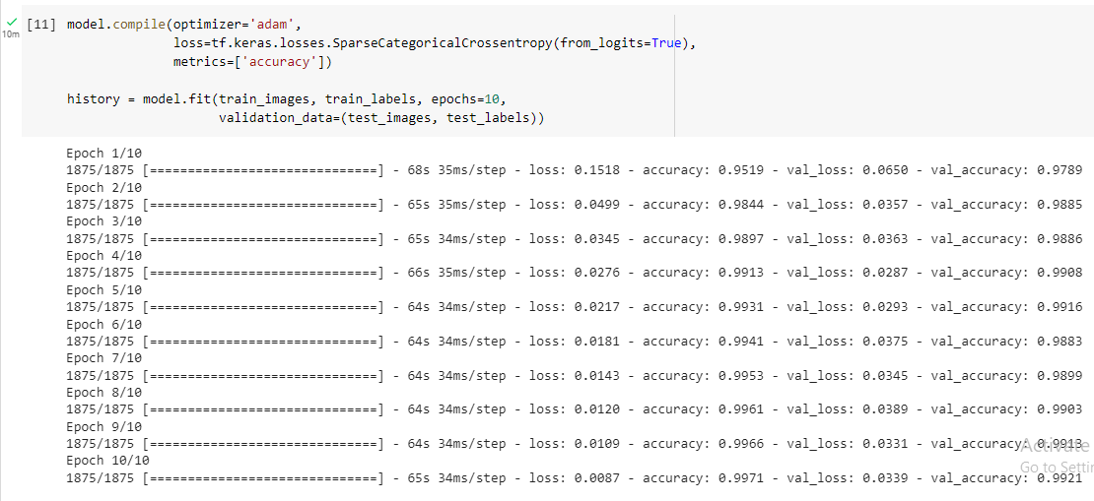
Compile and train the model

Slide 13
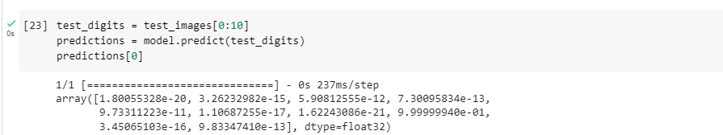

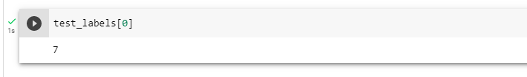
Using the model to make predictions

Slide 14


Evaluating the model on new data

Slide 15
Feature Extraction
Convolution layer
Relu activation function
Pooling layer
Flatten

Slide 16
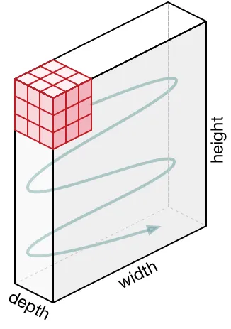

CONVOLUTIONAL LAYER
Convolutional layer : the primary purpose of convolution is to extract features from the input image. Convolution preserves the spatial convolution layer output y = $\sum_{i}^{n}{x ∗f}$

Slide 17
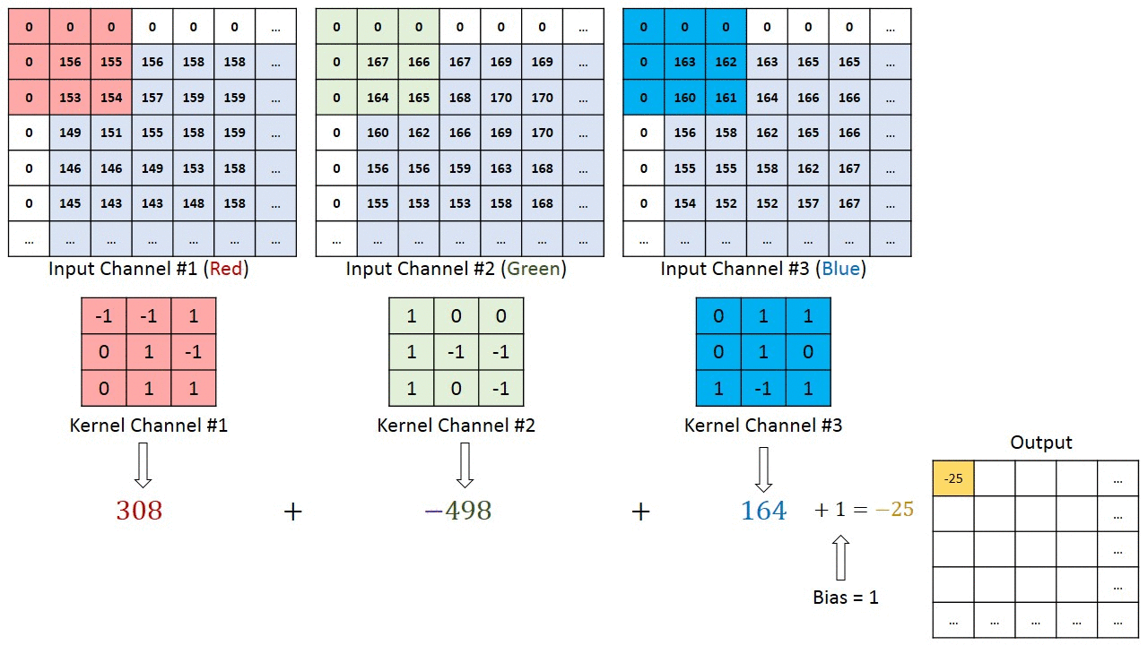
CONVOLUTIONAL LAYER OPERATION

Slide 18
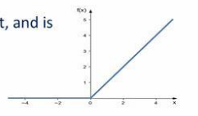
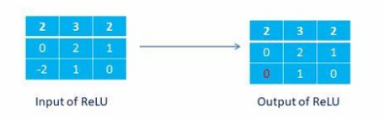
ReLU Function
ReLU stands for rectified linear unit, and
is a type of activation function.
f(x) = max(0,x)

Slide 19
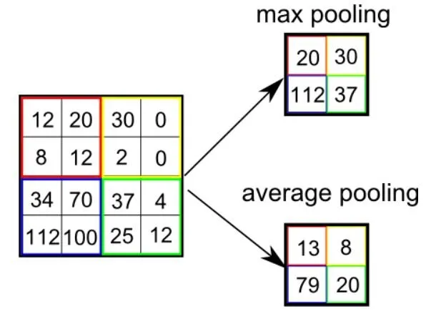
POOLING LAYER
Pooling layers would reduce the number of parameters when the inputs are too large.
Pooling also called down sampling which reduces the dimensionality of each map but retains important information.
Max Pooling, Average Pooling, Sum Pooling.

Slide 20
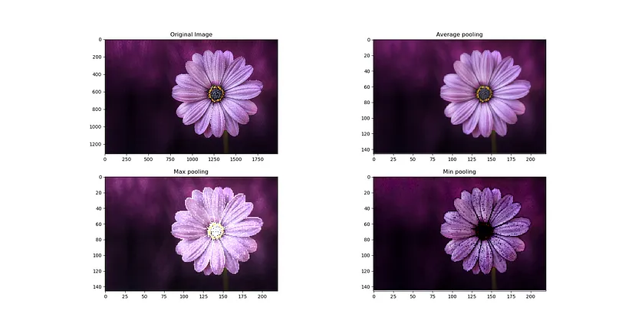
We cannot say that a particular pooling method is better over other generally. The choice of pooling operation is made based on the data at hand.
Average pooling method smooths the harsh edges of a picture and is used when such edges are not important.

Slide 21
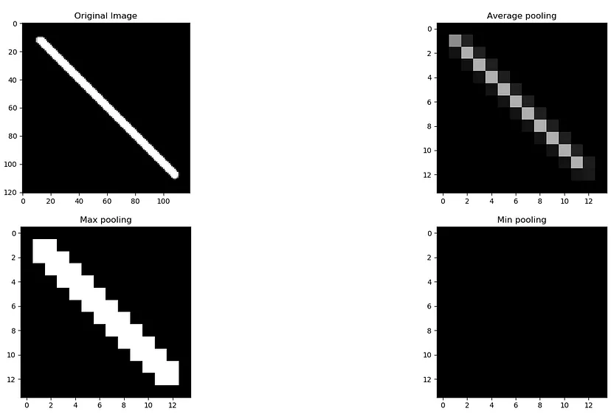
Max pooling selects the brighter pixels from the image. It is useful when the background of the image is dark, and we are interested in only the lighter pixels of the image.
For example: in MNIST dataset, the digits are represented in white color and the background is black. So, max pooling is used.

Slide 22
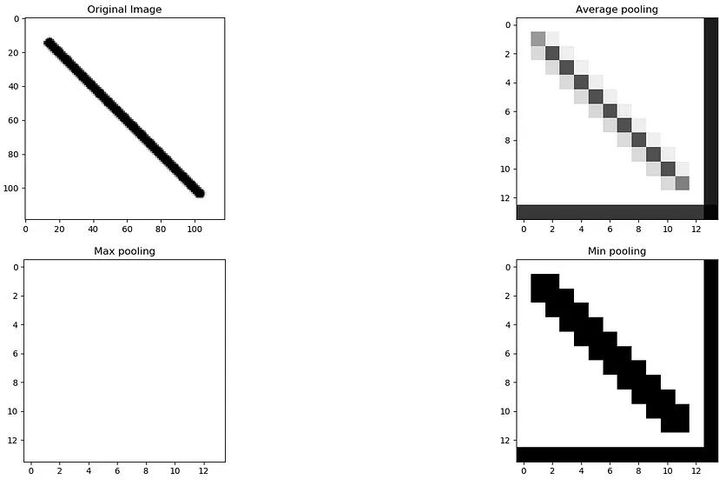
Min Pooling It is mostly used when the image has a light background since min pooling will select darker pixels.

Slide 23
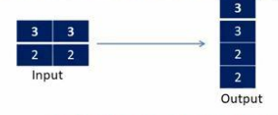
Flatten LAYER
The feature matrix will be converted as vector (x1,x2,x3,…)
Flattening

Slide 24
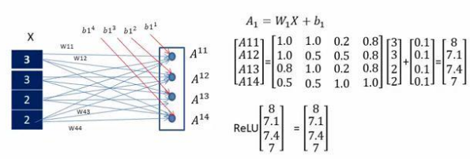
Fully-connected layer with ReLU

Slide 25
Advantages of CNN models
No human supervision.
High accuracy at image recognition.
Minimize computation.
Great for short texts (e.g., headlines).

Slide 26
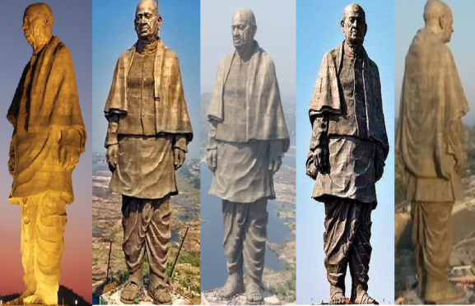
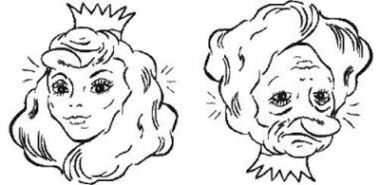
Disadvantages of CNN models
Classification of Images
with different Positions.
Fail to encode the position &
orientation of objects.
A lot of training data is needed.
Training process takes a long time.

